Slide 1

Real-time Personalization using Embeddings for Search Ranking at Airbnb

Slide 2
unique challenge：
two-sided marketplace
a user rarely consumes the same item twice and one listing

Slide 3

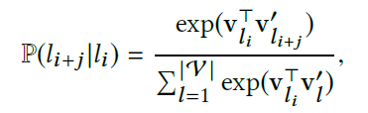

Methodology
Listing Embeddings:
A new session is started whenever there is a time gap of more than 30 minutes between two consecutive user clicks.

Slide 4
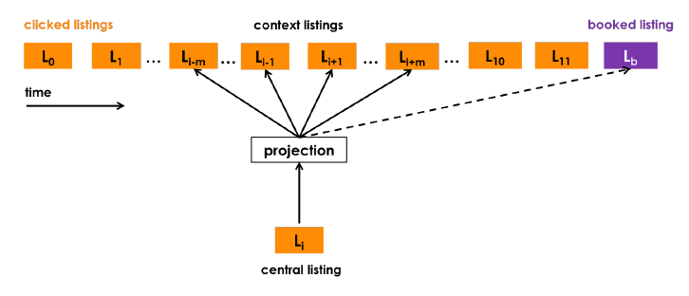

Booked Listing as Global Context
booked sessions can be used to adapt the optimization

Slide 5
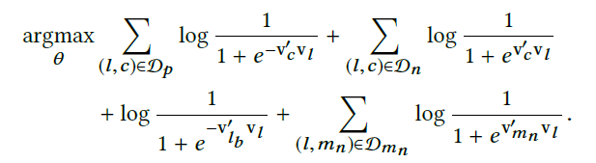
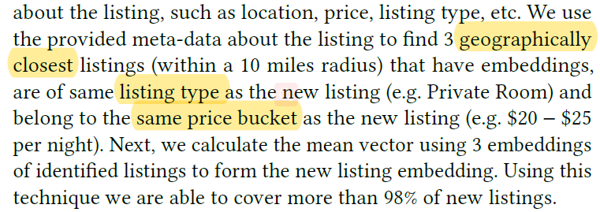
Adapting Training for Congregated Search
add a set of random negatives Dmn , sampled from the market of the central listing l
Cold start listing embeddings

Slide 6
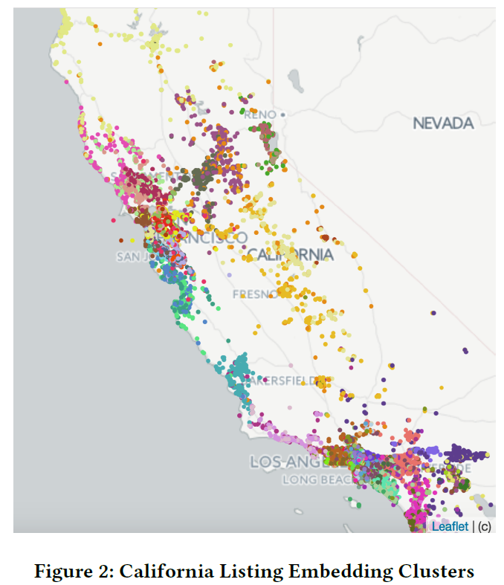
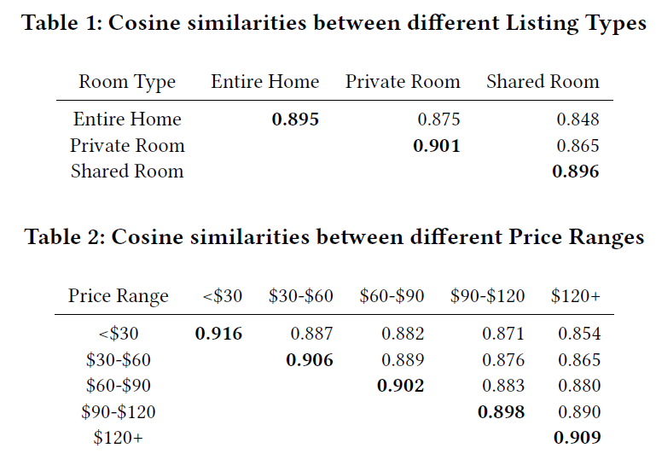
Examining Listing Embeddings
examine the d = 32 dimensional embeddings trained using (5) on 800 million click sessions

Slide 7
User-type & Listing-type Embeddings
Listing embeddings are suitable for short-term
booking sessions data Sb is much smaller than click sessions data S
many users booked only a single listing in the past
to learn a meaningful embedding for any entity from contextual information at least 5 − 10 occurrences of that entity are needed in the data
long time intervals may pass between two consecutive bookings by the user
learn embeddings at a level of listing_type instead of listing_id.

Slide 8
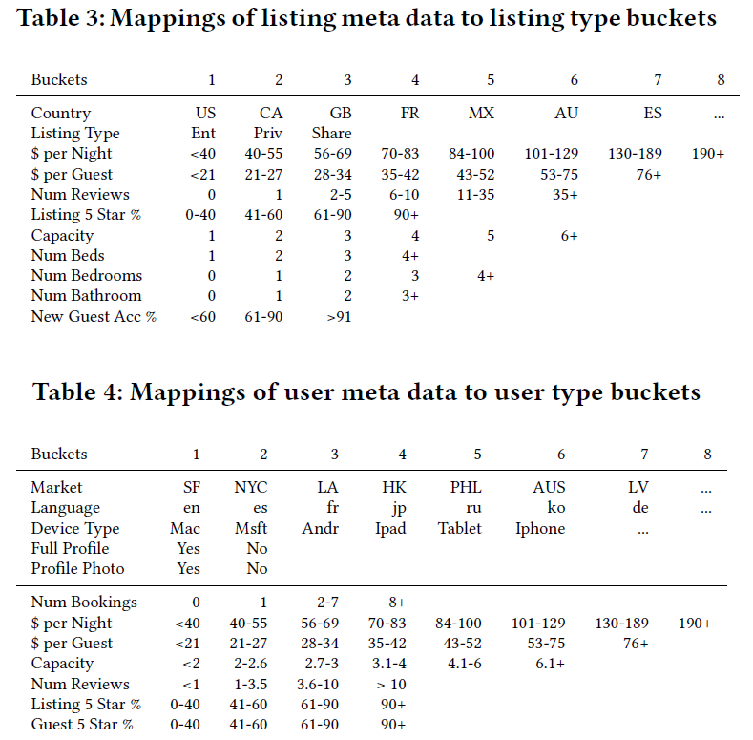
learn user_type embeddings in the same vector space as listing_type embeddings
The mapping from listing_id to a listing_type is a many-to-one mapping
For users who made their first booking user_type is calculated based on the first 5 rows from Table 4

Slide 9
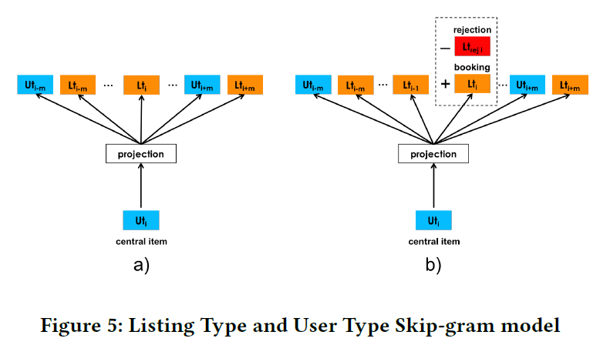


Training Procedure
Update the central item which is a user_type (ut )
listing_type (lt )
Since booking sessions by definition mostly contain listings from different markets, there is no need to sample additional negatives from same market as the booked listing

Slide 10
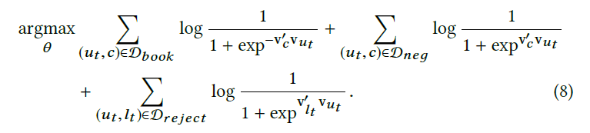
Explicit Negatives for Rejections
Unlike clicks that only reflect guest-side preferences, bookings reflect host-side preferences as well, as there exists an explicit feedback from the host

